Slide 1
HEART FAILURE MANAGEMENT
-RAAS BLOCKERS
FAZIL BISHARA
SR- CARDIOLOGY
Journal Review

Slide 2
TOPIC OVERVIEW
Introduction
Evidence on ACE-inhibitors & ARBs
Aldosterone Blockers
Renin inhibitors

Slide 3
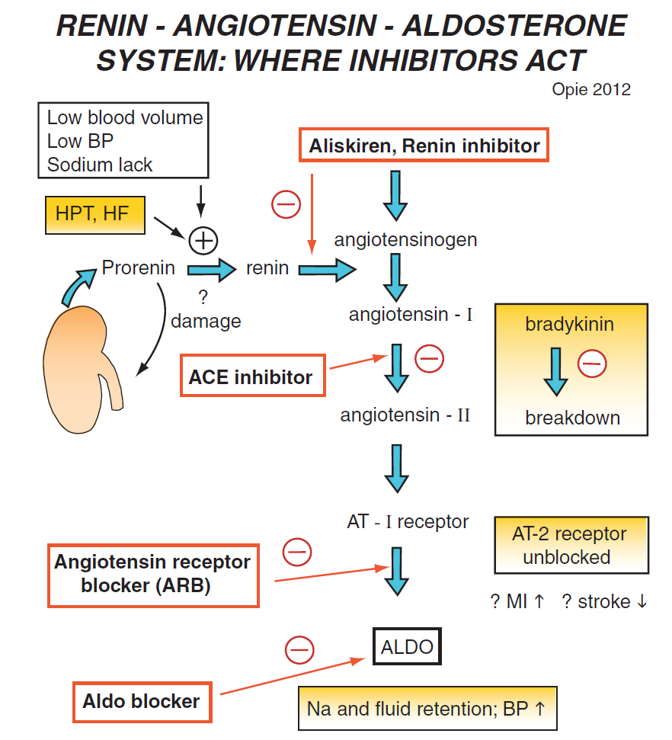
INTRODUCTION

Slide 4
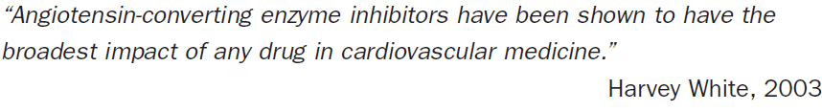
Ever since the introduction of the 1st ACE-i, captopril in 1977 , ACE inhibitor have become the cornerstone in the treatment of heart failure and left ventricular dysfunction.

Slide 5
ACE-inhibitors and ARBs in heart failure??
Are they useful in symptomatic heart failure?
Use in asymptomatic LV systolic dysfunction.
Role in heart failure with preserved EF
Utility in post MI- heart failure/LV dysfunction
Role in prevention of heart failure in patients without LV systolic dysfunction
What is the optimal dosing?

Slide 6
ACE- inhibitors & ARBs in symptomatic heart failure: evidence from clinical trials

Slide 7
Overview of Randomized Trials of Angiotensin-Converting Enzyme Inhibitors on Mortality and Morbidity in Patients With Heart Failure
Objective —To evaluate the effect of ACE inhibitors on mortality and morbidity in patients with symptomatic congestive heart failure.
Data were obtained for all completed, published or unpublished, randomized, placebo-controlled trials of ACE inhibitors that were at least 8 weeks in duration.
All patients in the analysis had symptomatic heart failure ( NYHA functional class II–IV), LV systolic dysfunction, or limitation of exercise duration.
JAMA. 1995;273(18):1450-1456. doi:10.1001/jama.1995

Slide 8
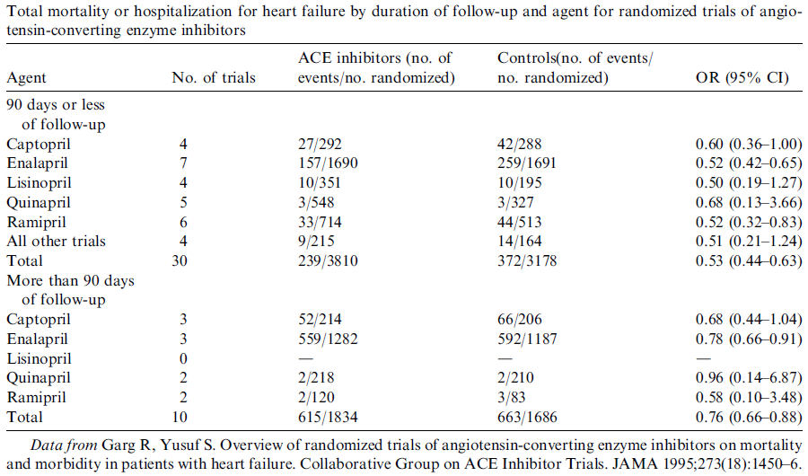
The reductions in total mortality and the combined endpoint of total mortality or hospitalization for heart failure were consistent in the various subgroups based on age, sex, NYHA class, and etiology, although the patients with greater LV systolic dysfunction (LV ejection fraction [LVEF] <25%) benefited the most.
conclusion: these trials have established the role of ACE inhibitors in reducing mortality and heart failure hospitalization in patients who have heart failure.

Slide 9
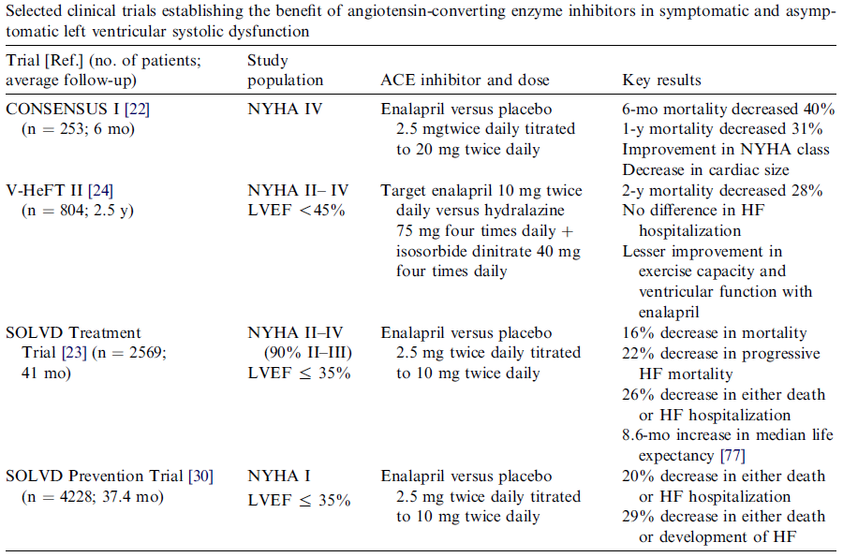

Slide 10
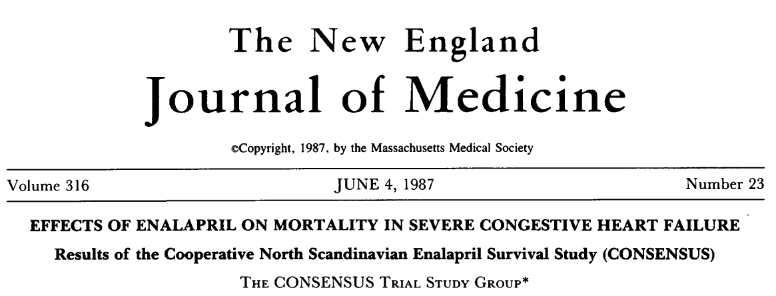
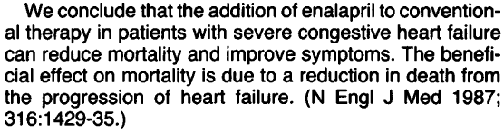
To evaluate the effect on mortality of enalapril as compared with placebo in addition to coventional therapy in severe CHF.
Inclusion criteria :Patients with severe congestive heart failure (NYHA class IV)

Slide 11
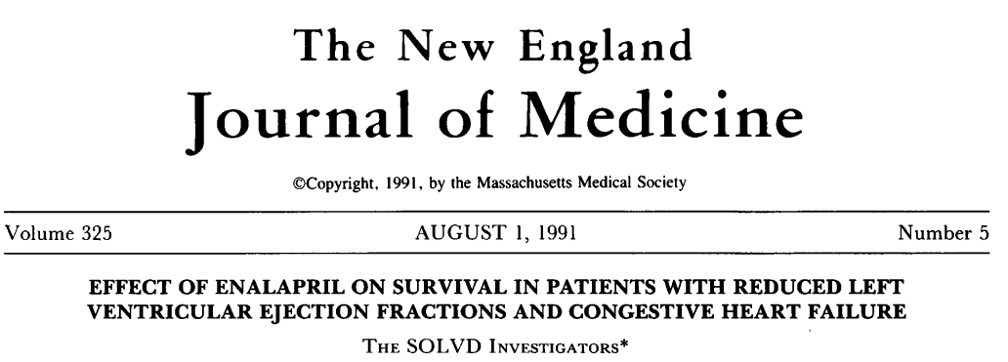
Patients receiving conventional treatment for HF were randomly assigned to receive either placebo (n =1284) or enalapril (n=1285) at doses of 2.5 -20mg/day in a double blind trial, majority of patients being in NYHA class 11-111
Avg. follow up- 41.4 months

Slide 12


Conclusion: the addition of enalapril to conventional therapy significantly reduced mortality and hospitalization for HF in patients with chronic congestive HF and low EF

Slide 13
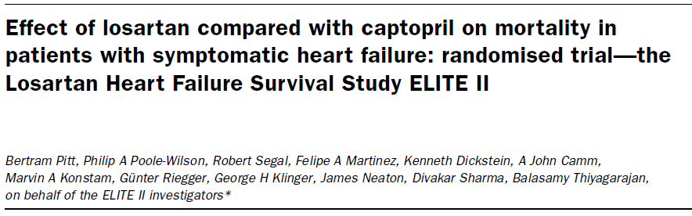
The ELITE II Losartan Heart Failure Survival Study was done to confirm whether losartan is superior to captopril in improving survival and is better tolerated.

Slide 14
A double-blind, randomised, controlled trial of 3152 patients aged 60 years or older with NYHA class II–IV HF and EF of 40% or less was undertaken.
Patients, stratified for - blocker use, were randomly assigned losartan (n=1578) titrated to 50 mg once daily or captopril (n=1574) titrated to 50 mg three times daily.
The primary and secondary endpoints were all-cause mortality, and sudden death or resuscitated arrest.

Slide 15
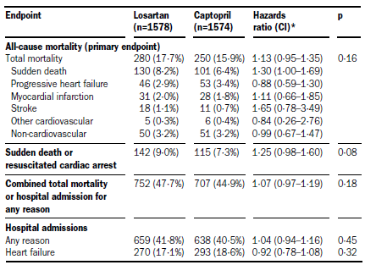
Interpretation: Losartan was NOT superior to captopril in improving survival in elderly heart-failure patients, but was significantly better tolerated.

Slide 16
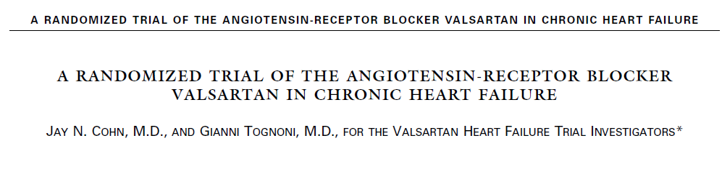
ValHeFT trial was the next large morbidity-mortality powered randomized clinical trial of an ARB in patients with CHF
A total of 5010 patients with heart failure of NYHA class II, III, or IV were randomly assigned to receive 160 mg of valsartan or placebo twice daily.

Slide 17
CONCLUSION-
Overall mortality was similar in the two groups.
Treatment with valsartan also resulted in significant improvements in NYHA class , EF, signs and symptoms of heart failure, and quality of life as compared with placebo (P<0.01)

Slide 18
ACE-inhibition in patients with symptomatic heart failure and preserved ejection fraction.
Data with ACE-i in this group of patients are limited.
The Perindopril in Elderly People with Chronic Heart Failure (PEP-CHF) study was a randomized, double-blind, placebo controlled trial evaluating the use of the ACE inhibitor, perindopril, in elderly patients with symptomatic heart failure, preserved LVEF and evidence of diastolic dysfunction.

Slide 19
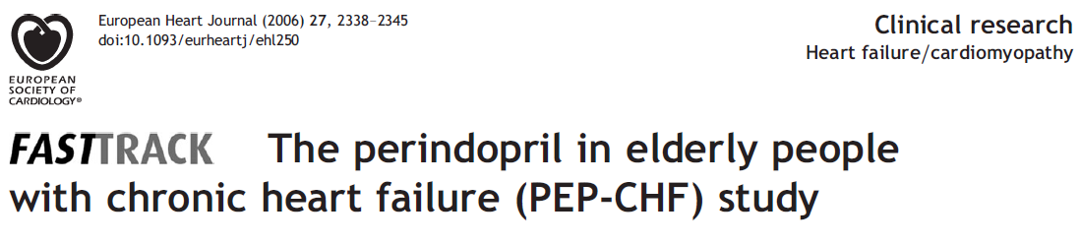
Methods: placebo compared with perindopril, 4 mg/ day in patients aged 70 years.
A total of 850 patients were randomized. Their mean age was 76 years and median follow-up was 2.1 years.
The primary endpoint was a composite of all-cause mortality and unplanned heart failure related hospitalization with a minimum follow-up of 1 year.

Slide 20
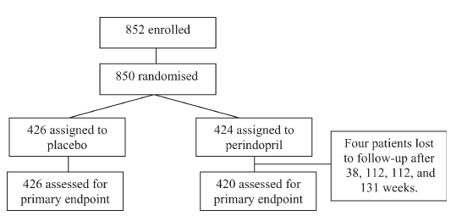
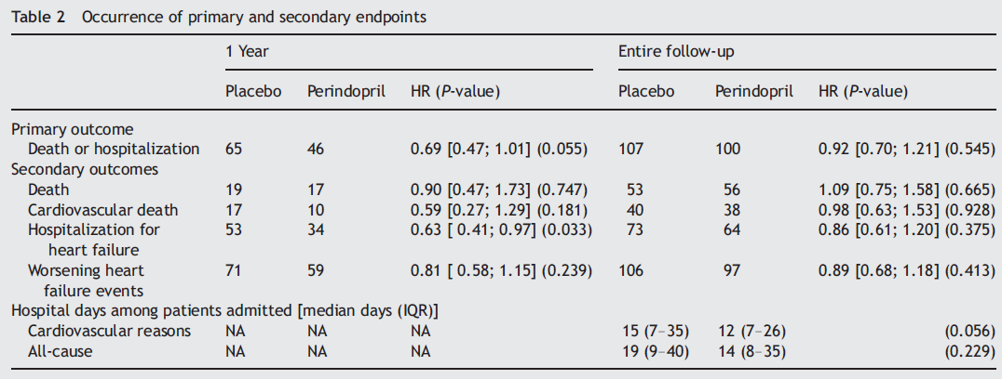

Slide 21
Conclusion of PEP-CHF
NO statistical benefit of ACE inhibitors on long-term morbidity or mortality in patients with heart failure and preserved ejection fraction!!!
But some improvement in
symptoms and exercise capacity
and possibly heart failure hospitalizations

Slide 22
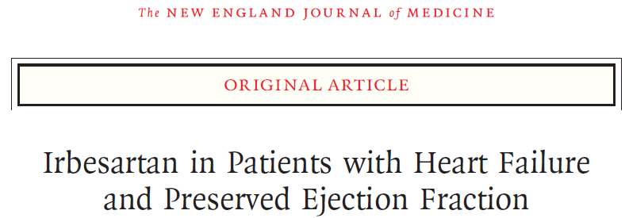
methods
4128 patients who were at least 60 years of age and had NYHA class II, III, or IV heart failure and an EF of at least 45% were randomly assigned to receive 300 mg of irbesartan or placebo per day.
mean follow-up of 49.5 months

Slide 23
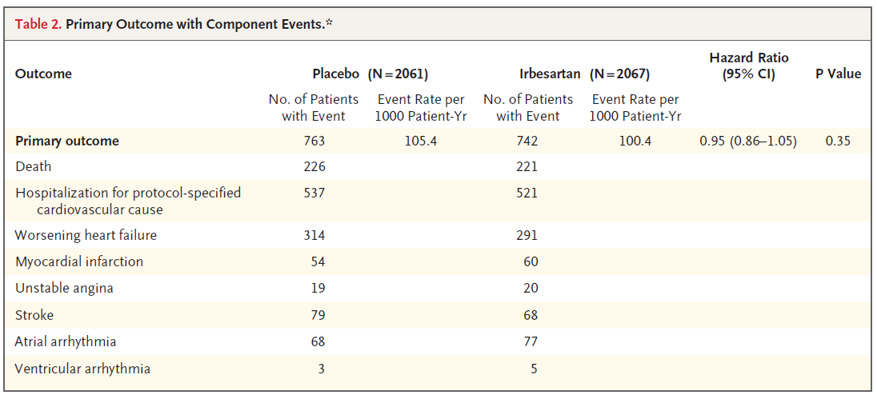
Conclusions
Irbesartan did not improve the outcomes of patients with heart failure and a preserved left ventricular ejection fraction.

Slide 24
Angiotensin-converting enzyme inhibitors in asymptomatic left ventricular systolic dysfunction

Slide 25
Patients who have asymptomatic LV dysfunction are at high risk for developing heart failure and for death.
These factors led to the evaluation of the effect of ACE inhibitors on morbidity, mortality, and development of heart failure in patients who have asymptomatic LV systolic dysfunction in the SOLVD Prevention Trial
Natural history of asymptomatic left ventricular systolic dysfunction in the community. Circulation 2003

Slide 26
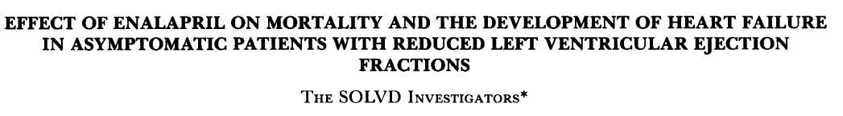
Patients were randomly assigned to receive either placebo (n=2117) or enalapril (n=2111) at doses of 2.5-20 mg/day in a double blind trial.
Followed up- average 37.4months

Slide 27
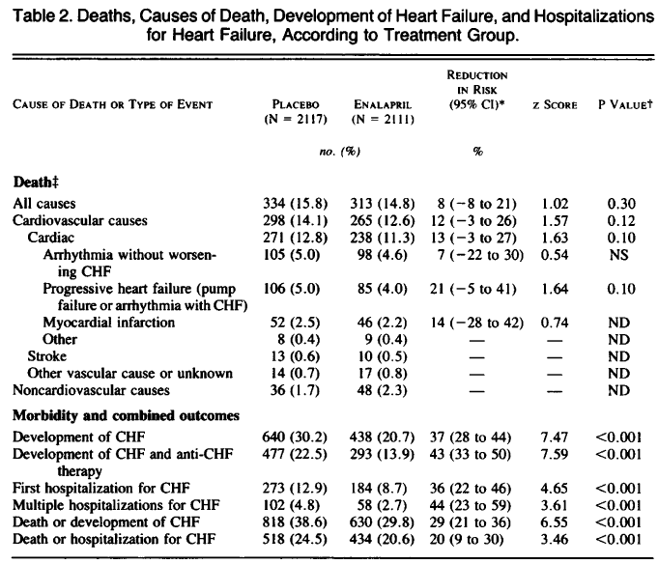

Slide 28
conclusion- SOLVD prevention
Enalapril produced an 8%, nonsignificant reduction in mortality (P =.30)
In the patient population with asymptomatic LV dysfunction, ACE inhibitors were associated with a significant benefit on morbidity but not on mortality.

Slide 29
ACE inhibition & ARBs in patients who have heart failure or left ventricular systolic dysfunction post–myocardial infarction

Slide 30
There is a marked increase in fatal and nonfatal cardiovascular events among survivors of acute myocardial infarction , with the degree of LV dysfunction being the most important determinant of the increased risk.
Studies have demonstrated the efficacy of ACE inhibition in the attenuation of LV dilatation and progressive LV dysfunction.
Results of the survival and ventricular enlargement trial.
The SAVE Investigators. N Engl J Med 1992

Slide 31
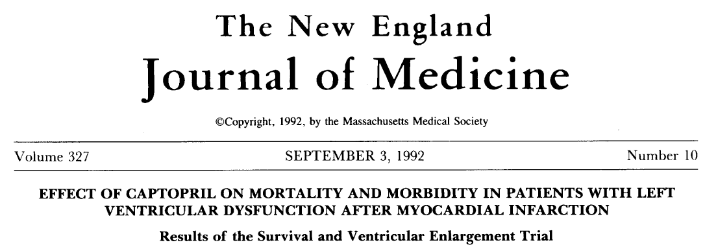
Methods: within 3-16 days after acute MI, 2231 patients with EF<40% but without overt HF or symptoms of myocardial ischemia were randomly assigned to receive either placebo (n=1116) or captopril (n=1115), followed up for an average of 42 months.

Slide 32
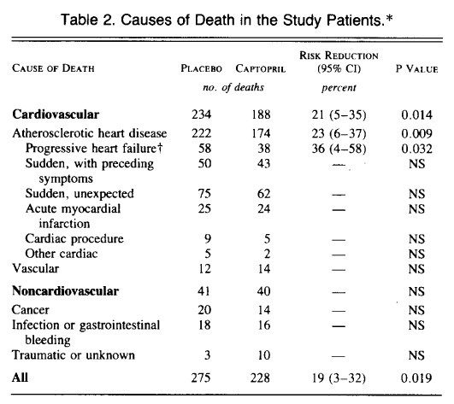

Slide 33
Conclusion- SAVE trial
Captopril improved survival and reduced morbidity and mortality , in patients with asymptomatic LV dysfunction post MI.
These benefits were observed in patients who received thrombolysis/aspirin/beta-blockers, as well as those who did not.

Slide 34
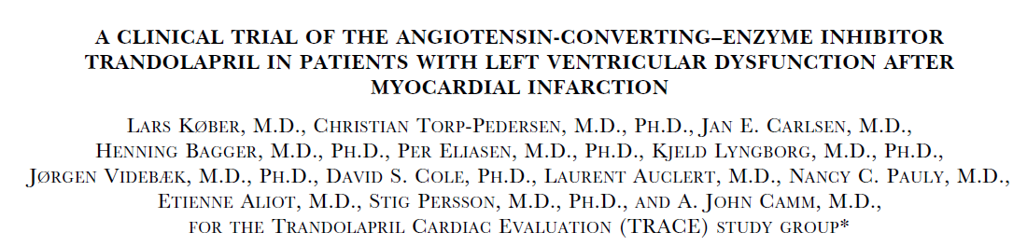
Background:
Treatment with ACE inhibitors reduces mortality among survivors of acute myocardial infarction, but whether to use ACE inhibitors in all patients or only in selected patients is uncertain.

Slide 35
Methods:
On days 3 to 7 after infarction, 1749 patients were randomly assigned to receive oral trandolapril (876 patients) or placebo (873 patients). The duration of follow-up was 24 to 50 months.

Slide 36
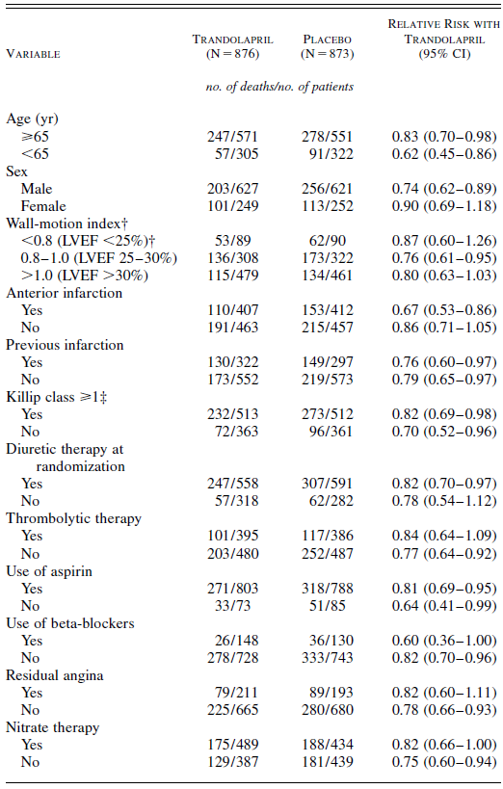
Conclusion:
Long-term treatment with trandolapril in patients with reduced LV function soon after MI significantly reduced the risk of overall mortality, mortality from cardiovascular causes, sudden death, and the development of severe heart failure.

Slide 37
AIRE study
acute infarction ramipril efficacy study
AIRE Study demonstrated efficacy of ramipril on mortality and morbidity in CHF post-MI NYHA class I-III patients
2006 patients enrolled in a double-blind,randomized, placebo-controlled study, followed up for 15 months.
Lancet. 1993; 342:821-828

Slide 38
Significant reduction in all cause mortality in ramipril group compared to placebo (17 vs 23%, relative risk reduction 23%, p=0.002)
Reduction in mortality apparent as early as 30 days and consistent across a wide range of subgroups.
Fewer patients in ramipril group developed severe/resistant HF
No significant reduction in re-infarction or stroke

Slide 39
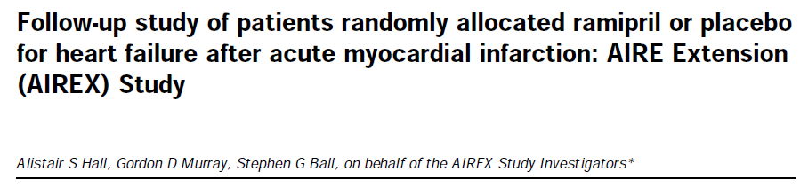
Evaluated the duration of long-term survival benefit of ramipril for CHF post-MI
The longest ACE inhibitor patient follow-up trial - the first and only ACE inhibitor study with proven 5-year results
Lancet. 1997; 349:1493-1497

Slide 40
After 5 years, patients previously randomized to placebo had a 38.9% mortality rate compared with 27.5% for those previously randomized to ramipril.
-- 36% reduction in mortality rate –
AIREX researchers recommended that ACE inhibitor therapy be continued indefinitely for patients post-MI
Lancet. 1997; 349:1493-1497

Slide 41
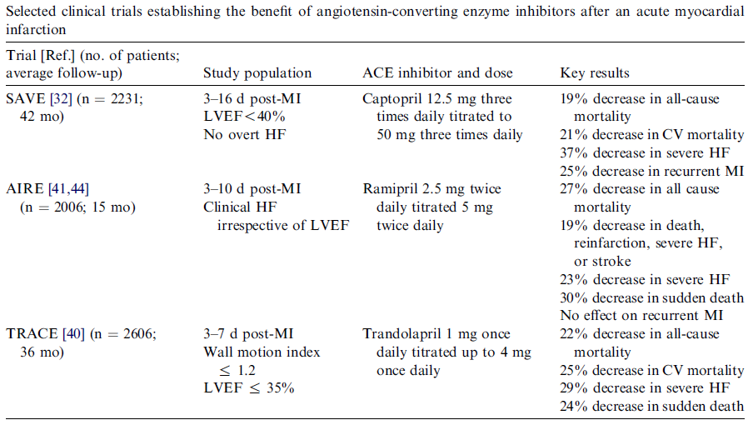
An overview of these trials showed that mortality was significantly reduced from 26.5% to 22.1% (p = 0.00001) in patients receiving ACE inhibitors. In absolute terms this corresponds to 44 lives saved per 1000.

Slide 42
WHEN TO TREAT?
There is no evidence of a time related benefit of ACE inhibitors. However, mechanistic studies have shown that early treatment reduces infarct expansion and ventricular enlargement.
WHO TO TREAT?
With the exception of elderly patients, predictors of an increased risk of death such as- Prior MI,
diabetes,
anterior MI location,
elevated heart rate
Killip class > 1
were associated with greater benefits of ACE inhibitor treatment.

Slide 43

CLINICAL RECOMMENDATIONS
ACE inhibitors should be considered in every MI patient with a systolic blood pressure higher than 100 mm Hg, provided there is no clear contraindication, soon after the administration of other recommended treatments.
Elderly patients (over 75 years) are at increased risk of hypotension and there is no evidence in the overview of a survival advantage in this group.

Slide 44
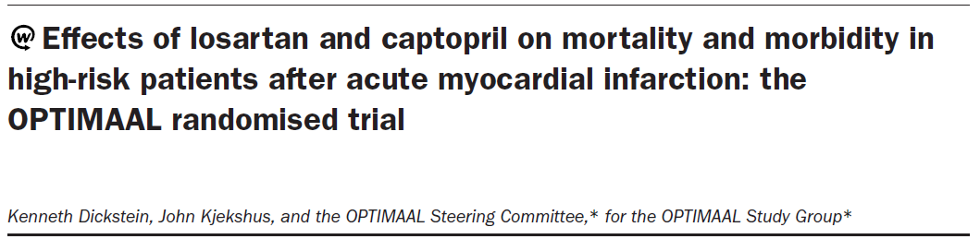
Done to test the superiority of losartan over captopril in high risk patients following acute MI.
5477 patients 50 years of age or older with confirmed acute MI and HF during the acute phase or a new Q-wave anterior infarction or reinfarction, were recruited from 329 centres in seven European countries.

Slide 45
Patients were randomly assigned and titrated to a target dose of losartan (50 mg once daily) or captopril (50 mg three times daily) as tolerated.
The primary endpoint was all-cause mortality.
Interpretation
non-significant difference in total mortality in favour of captopril noted.
ACE inhibitors should remain first-choice treatment in patients after complicated acute myocardial infarction.

Slide 46
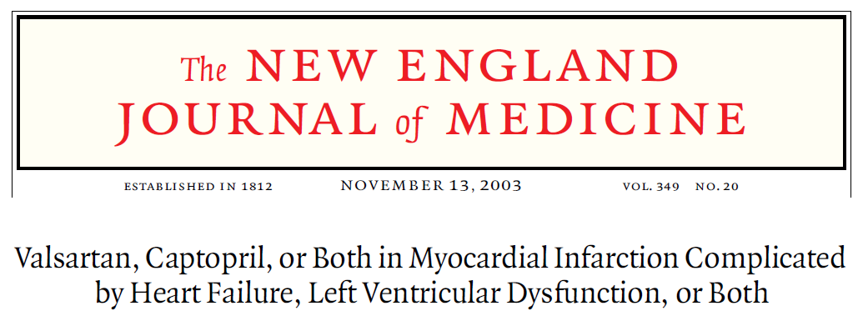
Valsartan in Acute Myocardial Infarction (VALIANT) trial
methods
Patients receiving conventional therapy were randomly assigned, 0.5 to 10 days after acute myocardial infarction, to additional therapy with valsartan (4909 patients), valsartan plus captopril (4885 patients), or captopril (4909 patients).
The primary end point was death from any cause.

Slide 47
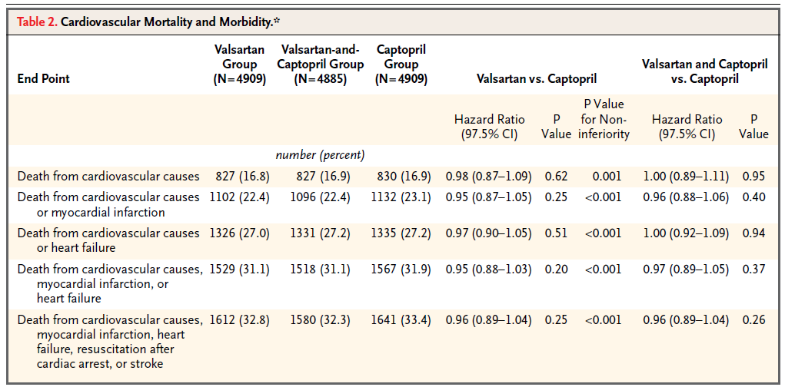
conclusions
Valsartan is as effective as captopril in patients who are at high risk for cardiovascular events after myocardial infarction. Combining valsartan with captopril increased the rate of adverse events without improving survival.

Slide 48
Lessons from VALIANT & OPTIMAAL
In the setting of HF after acute MI, the high dose of valsartan (target 320 mg daily) used in the VALIANT trial was non-inferior to captopril (target 150 mg daily) for clinical outcomes, whereas the dose of losartan (target 50 mg daily) used in the OPTIMAAL trial did not achieve non-inferiority to the same target dose of captopril (target 150 mg daily).

Slide 49
Angiotensin-converting enzyme inhibition and prevention of heart failure in patients without left ventricular systolic dysfunction

Slide 50
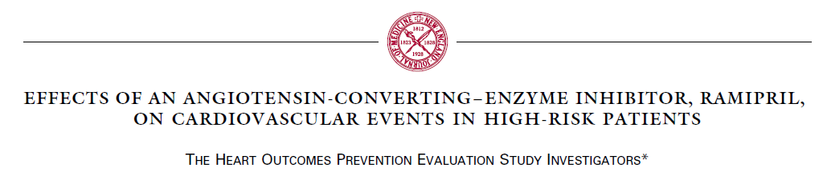

HOPE assessed the role of an ACE-inhibitor, ramipril, in patients who were at high risk for cardiovascular events but do not have left ventricular dysfunction or heart failure yet.

Slide 51
A total of 9297 elderly patients (> 55 years of age) with a history CAD, stroke, PVOD, or DM plus at least one other cardiovascular risk factor (hypertension, elevated total cholesterol levels, low HDL levels, cigarette smoking, or documented micro-albuminuria) were randomized to receive either ramipril at a target dose of 10 mg/d or placebo for an average of 5 years.

Slide 52
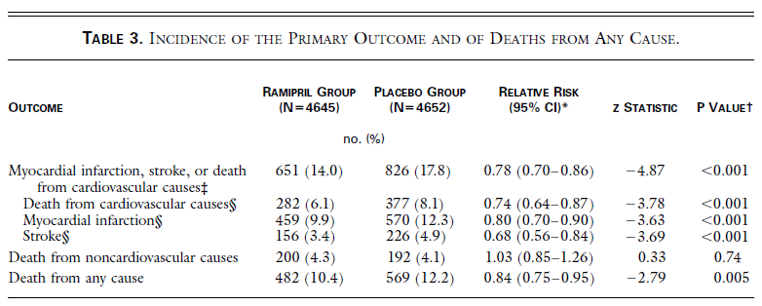
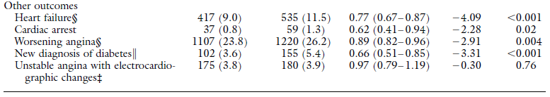
The HOPE trial hence confirms thatRamipril significantly reduces the rates of death, myocardial infarction, and stroke in a broad range of high-risk patients who are not known to have a low ejection fraction or heart failure.

Slide 53
CHARM Trial
7,601 patients with heart failure
3 Individual component randomized trials with the ARB candesartan (4 or 8 mg/day, titrated to target dose of 32 mg) or placebo
CHARM Added
Patients with LVEF <40% and treated with an ACE-inhibitor
CHARM Alternative
Patients with LVEF <40% and ACE-inhibitor intolerant
CHARM Preserved
Patients with LVEF >40% with or without ACE-inhibitor
Endpoints (follow-up minimum 2 years):
  Primary – Component trials: cardiovascular mortality or CHF hospitalization
  Primary – Overall trial results: All-cause mortality

Slide 54
CHARM- Added Trial
CV Mortality or
CHF hospitalization
HR 0.85
p=0.011
CV Mortality
HR 0.84
p=0.02

Slide 55
CHARM -Alternative Trial
CV Mortality or
CHF hospitalization
HR 0.77
p=0.0004
CV Mortality
HR 0.85
p=0.072
European Society of Cardiology 2003

Slide 56
CHARM- Preserved Trial
CV Mortality or
CHF hospitalization
HR 0.89
p=0.118
CV Mortality
HR 0.99
p=0.918
European Society of Cardiology 2003

Slide 57
Choice of angiotensin-converting enzyme inhibitors/ARBs and their optimal dosing
ACE inhibitors are generally prescribed by physicians in doses lower than the large doses that have been shown to reduce morbidity and mortality in patients with heart failure. It is unclear, however, if low doses and high doses of ACE inhibitors have similar benefits.

Slide 58
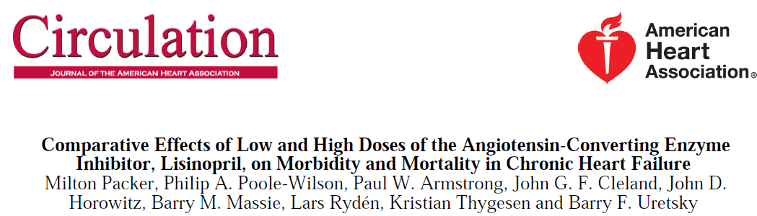
Assessment of Treatment with Lisinopril and Survival (ATLAS) study:
3164 patients with NYHA class II to IV heart failure and an EF<30% were assigned to double-blind treatment with either low doses (2.5 to 5.0 mg daily) or high doses (32.5 to 35 mg daily) of the ACE inhibitor, lisinopril, for 39 to 58 months, while background therapy for heart failure was continued.

Slide 59
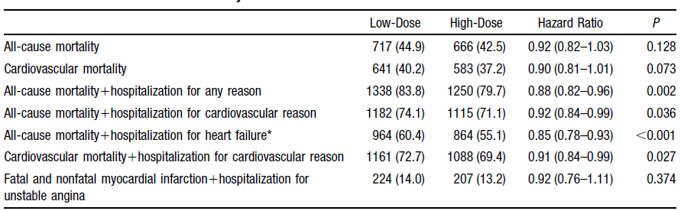
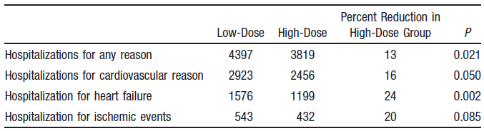

Slide 60
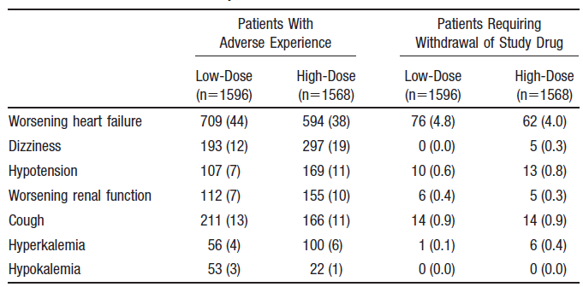
ATLAS TRIAL concluded that patients with heart failure should not generally be maintained on very low doses of an ACE inhibitor ,unless these are the only doses that can be tolerated .

Slide 61
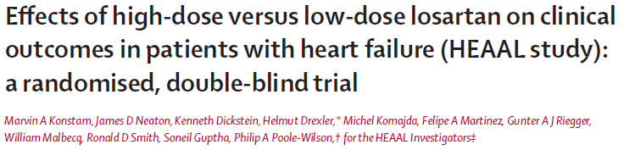
METHODS: 3846 patients with heart failure 0f NYHA class II–IV, LVEF 40% or less, and intolerance to ACE inhibitors were randomly assigned to losartan 150 mg (n=1927) or 50 mg daily (n=1919).
The primary endpoint was death or admission for heart failure.

Slide 62
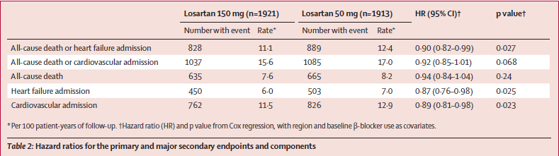
High or low dose???
The results from these two trials,
ATLAS and HEAAL indicate that more benefit is obtained from using higher doses of RAAS blockers and underscore the importance of attaining, if possible, the target doses proven to be of benefit in the key RCTs
Conclusion: for patients with heart failure and reduced LVEF who are ACE-inhibitor intolerant, losartan 150 mg daily is superior to 50 mg daily with respect to the composite outcome of death or admission for heart failure.

Slide 63
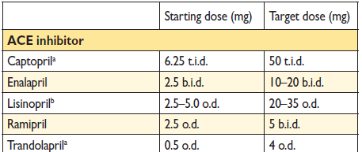
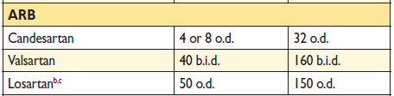
Evidence-based doses of disease-modifying drugs used in key randomized trials in heart failure.

Slide 64
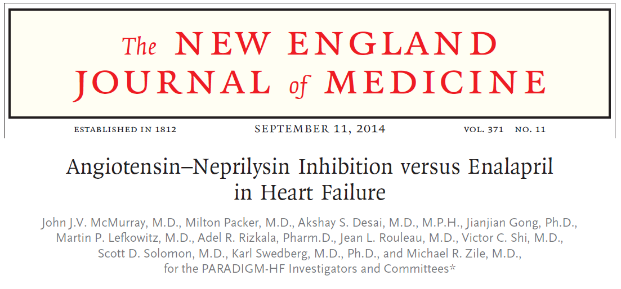
Prospective Comparison of ARNI with ACE-I to Determine Impact on Global Mortality and Morbidity in Heart Failure Trial (PARADIGM-HF)
Methods
In this double-blind trial, 8442 patients with class II, III, or IV HF and an EF of 40% or less were assigned to receive either LCZ696 (at a dose of 200 mg twice daily) or enalapril (at a dose of 10 mg twice daily), in addition to recommended therapy.

Slide 65
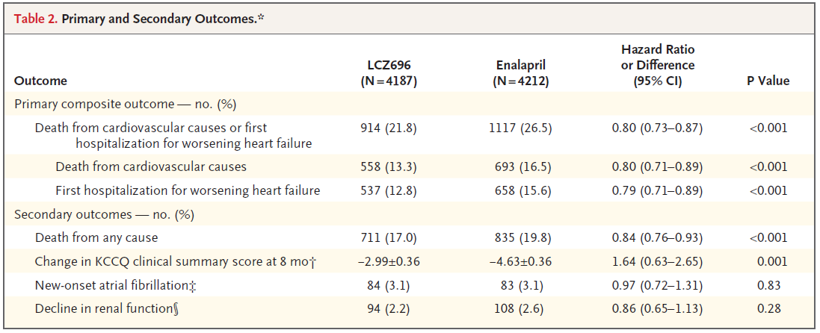
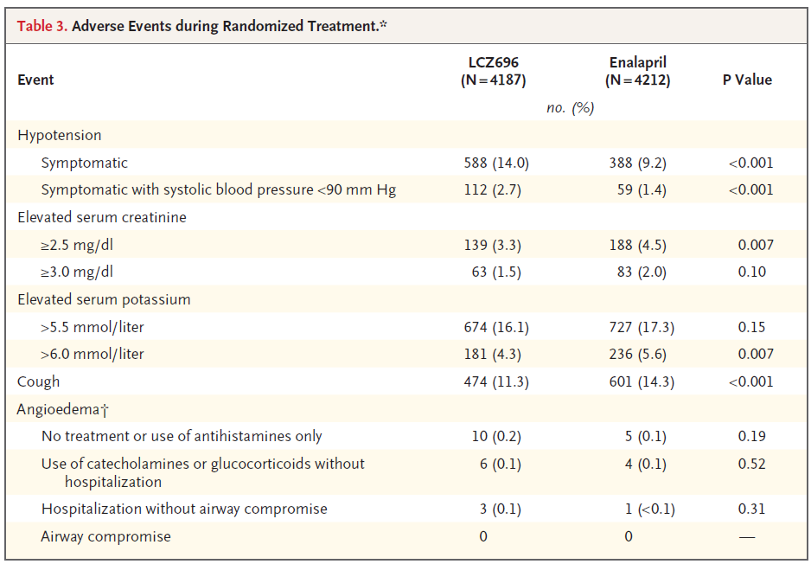
Conclusions
LCZ696 was superior to enalapril in reducing the risks of death and of hospitalization for heart failure.

Slide 66
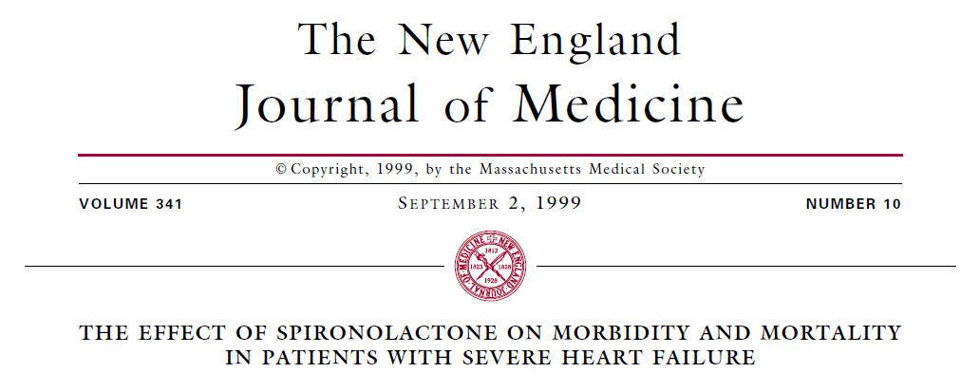
Role of aldosterone blockade in heart failure
In a doubleblind study, 1663 patients who had severe heart failure and a left ventricular ejection fraction of no more than 35 percent were enrolled , who were on standard heart failure therapy.
A total of 822 patients were randomly assigned to receive 25 mg of spironolactone daily, and 841 to receive placebo. The primary end point was death from all causes.

Slide 67
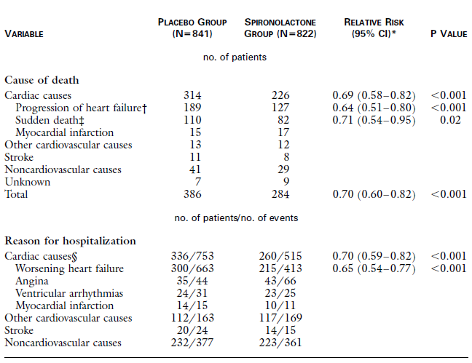
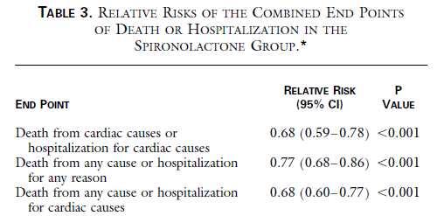
Conclusions
Blockade of aldosterone receptor by spironolactone, in addition to standard therapy, substantially reduces the risk of both morbidity and death among patients with severe heart failure.

Slide 68
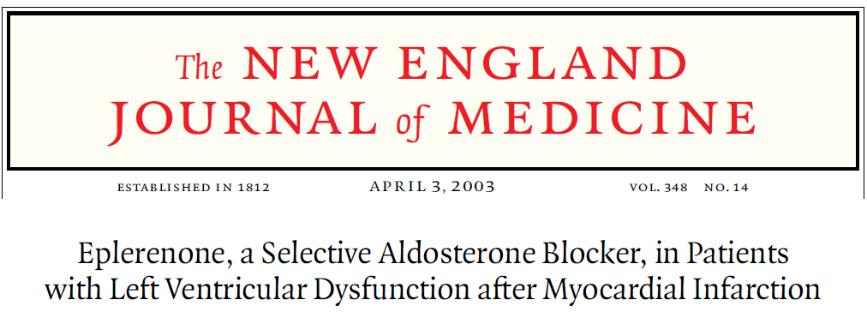
( Eplerenone Post–Acute Myocardial Infarction Heart Failure Efficacy and Survival Study Investigators)
A double-blind, placebo-controlled study evaluating the effect of eplerenone, on morbidity and mortality among patients with acute MI complicated by LV dysfunction and heart failure.

Slide 69
methods
Patients were randomly assigned to eplerenone (25 mg per day initially, titrated to a maximum of 50 mg per day; 3313 patients) or placebo (3319 patients) in addition to optimal medical therapy.
mean follow-up - 16 months
478 deaths in the eplerenone group and 554 deaths in the placebo group (relative risk, 0.85; 95 percent confidence interval, 0.75 to 0.96; P=0.008).

Slide 70
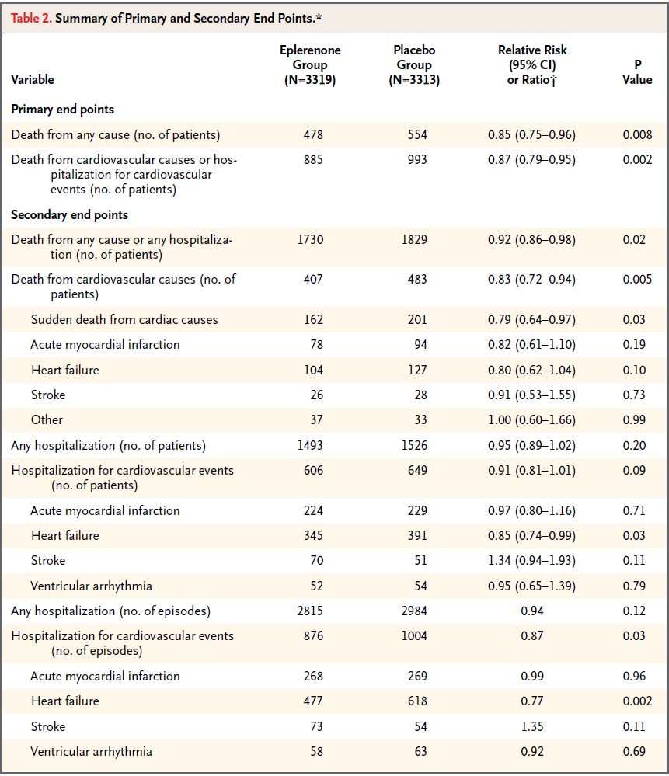
conclusions
The addition of eplerenone to optimal medical therapy reduces morbidity and mortality among patients with acute myocardial infarction complicated by left ventricular dysfunction and heart failure.

Slide 71
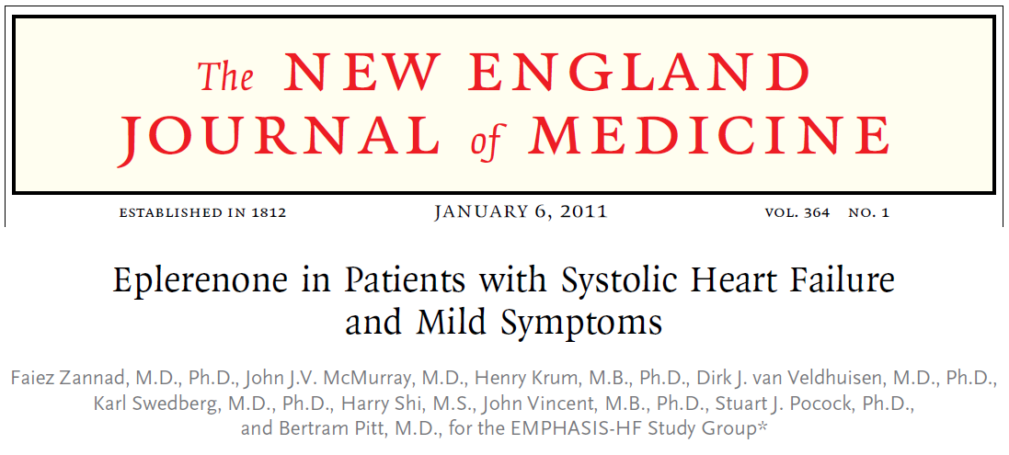
Eplerenone in Mild Patients Hospitalization and Survival Study in Heart Failure (EMPHASIS-HF)
METHODS
In this randomized, double-blind trial, 2737 patients with NYHA class II heart failure and an EF < 35% were assigned to receive eplerenone (up to 50 mg daily) or placebo, in addition to recommended therapy.

Slide 72
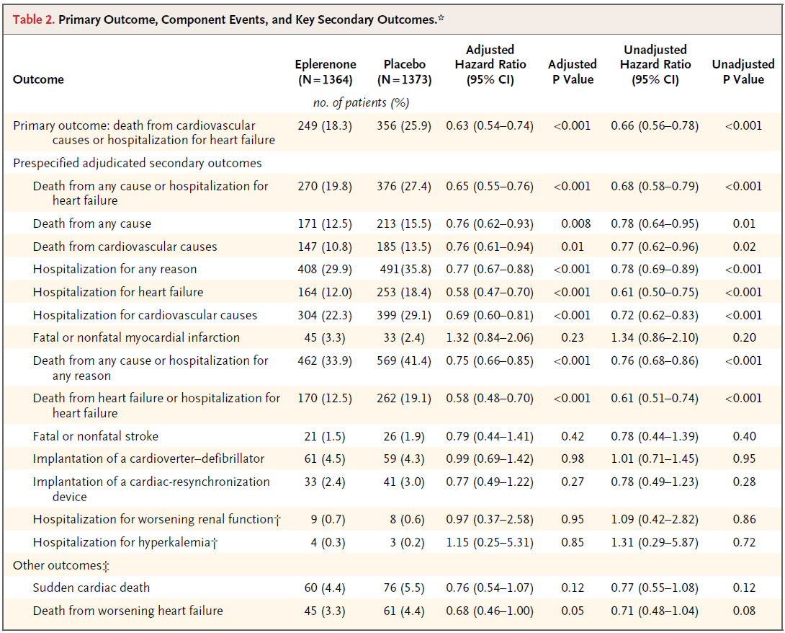
CONCLUSIONS
Eplerenone, as compared with placebo, reduced both the risk of death and the risk
of hospitalization among patients with systolic heart failure and mild symptoms.

Slide 73
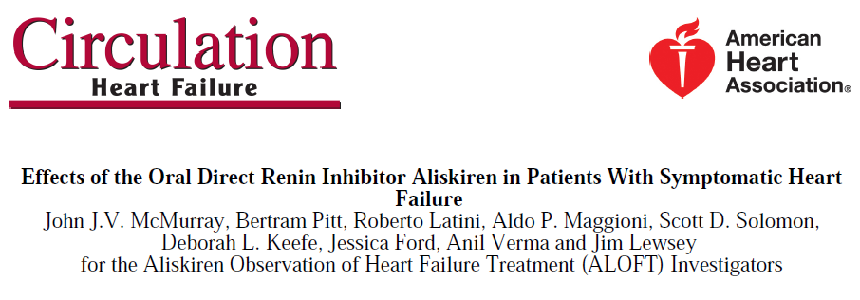
methods
Patients with NYHA class II to IV HF, hypertension, and plasma BNP concentration 100 pg/mL who had been treated with an ACE inhibitor ARB and beta-blocker were randomized to 3 months of treatment with placebo (n=146) or aliskiren 150 mg/d (n=156).
The primary efficacy outcome was the between-treatment difference in N-terminal pro-BNP.

Slide 74
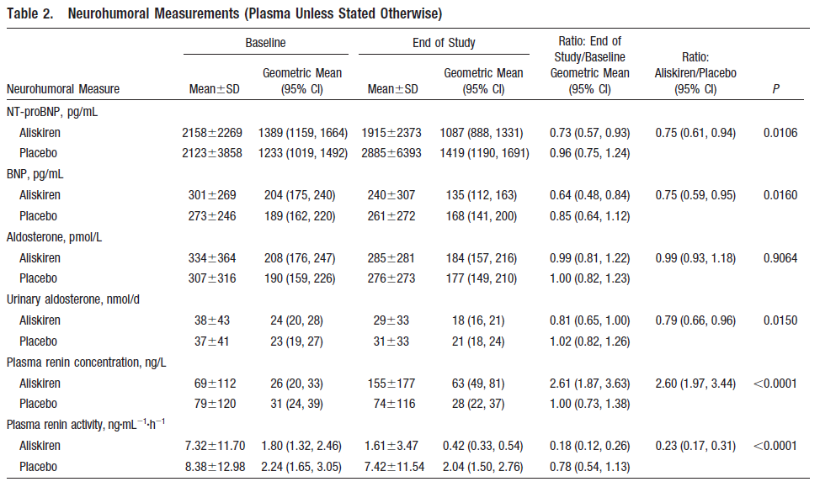
Conclusions—
Addition of aliskiren to an ACE inhibitor (or angiotensin receptor blocker) and beta blocker had favourable neurohumoral effects in heart failure and appeared to be well tolerated.

Slide 75
TAKE HOME MESSAGE
ARBs remain recommended as an alternative in patients intolerant of an ACE inhibitor
Since MRA treatment reduced all-cause mortality, whereas ARB ‘add-on’ treatment did not, ARBs are no longer the first choice recommendation in patients with HF and an EF ≤40% who remain symptomatic despite optimal treatment with an ACE inhibitor and beta-blocker.

Slide 76
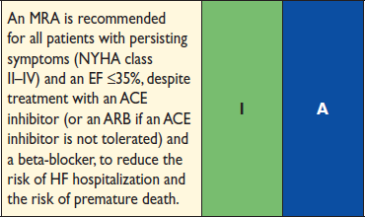


ESC guidelines for ACE-I, ARBs and AA in heart failure
DRI are not presently recommended as an alternative to an ACE inhibitor or ARB

